Slide 1
Python Unit/Functional Testing

Slide 2
Types of Tests
Unit test
Functional Test
System Test
Integration Tests
Regression Test – Changes in the code (to fix something or to add new feature) introduced new defects (Breaks existing functionality).
Build Verification test (BVT)
Performance Test
Load Tests
Accessibility Testing
Global Verification testing
Translation Verification testing
Security Testing

Slide 3
Assert (True / False)
Reports
Different python test file
Data setup
Code Coverage

Slide 4
Pre-requisites
Downloads
Python 3 - https://www.python.org/downloads/
Pytest - https://docs.pytest.org/en/stable/getting-started.html
Verify python installation
Python –version
Python 3.8.5
Verify pytest installation
pytest --version
pytest 6.0.1
Documentation
https://docs.pytest.org/en/stable/usage.html

Slide 5
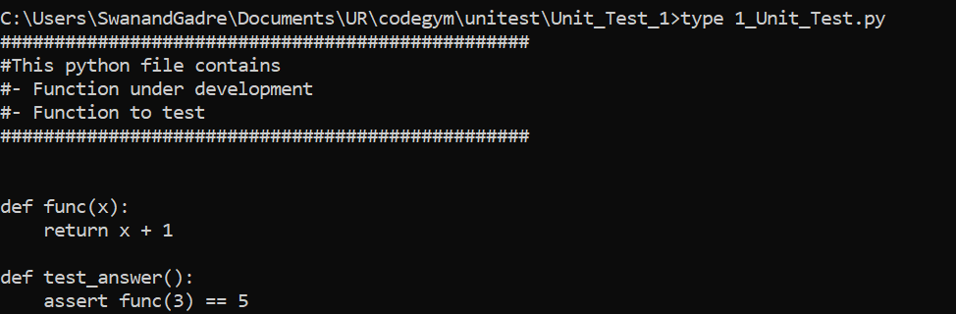
Example First Unit Test (Unit_Test_1)
How to run test
Pytest –v <test python file>.py

Slide 6
Assertion
Assertions are checks that return either True or False status.
In pytest, if an assertion fails in a test method, then that method execution is stopped there.
The remaining code in that test method is not executed, and pytest will continue with the next test method.

Slide 7
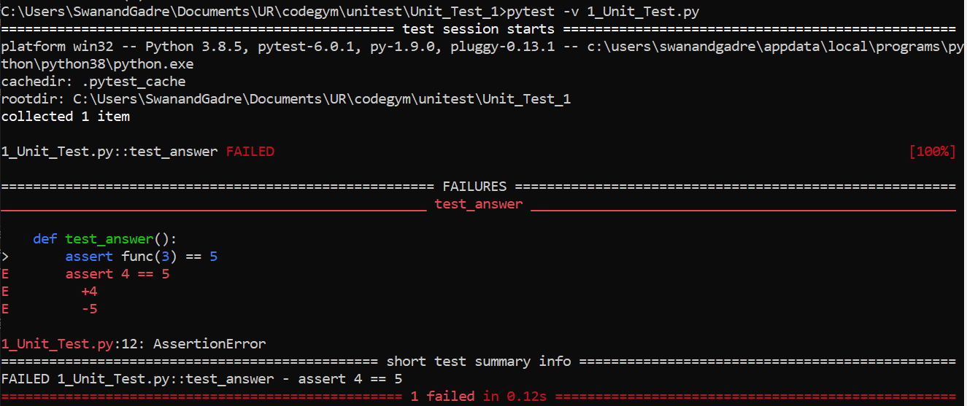
Example First Unit Test

Slide 8
Report Details
Detailed reason of function which is failed
Short summary of the failed function
Total test passed / failed

Slide 9
Troubleshooting Tips
Verify that the function should have “test_” to qualify it as a test
If you just run pytest, it will look for all the .py filenames with prefix as “test_” or suffix as “_test”.
If you just run pytest <test case file name>.py. It doesn’t show the details of test cases which are passed. It only shows details of the failure. If you want to see details of passed test cases choose pytest -v

Slide 10
Some more simple Unit Tests (Unit_Test_2)
Parameterization test
Wallet test
Comment wallet.py line 11 and 12 – See the results, where test_wallet_spend_cash_raises_exception_on_insufficient_amount test failed.

Slide 11
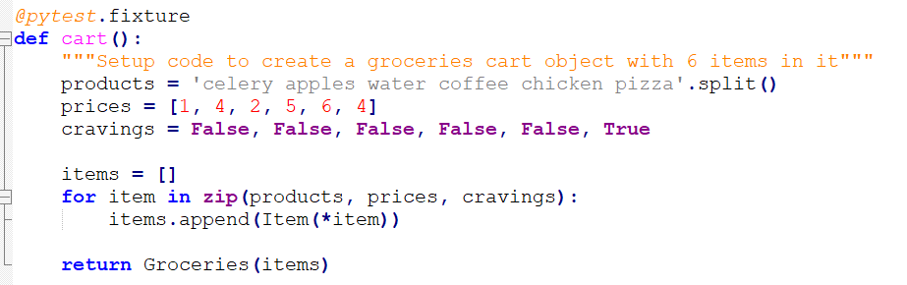
Data setup (Unit_Test_3)
If your tests need to work on data you typically need to set them up. This is often a process that has to be repeated and independent for each test.

Slide 12
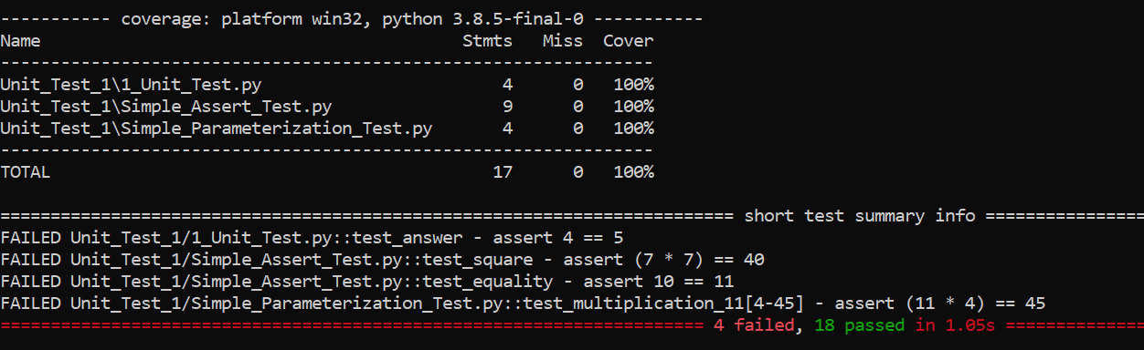
Pytest-cov
pytest --cov=Unit_Test_1/

Slide 13
Backup

Slide 14
References
Python code coverage (pytest-cov) - https://pypi.org/project/pytest-cov/
Python 3 - https://www.python.org/downloads/
Pytest - https://docs.pytest.org/en/stable/getting-started.html
https://docs.pytest.org/en/stable/usage.html

Slide 15
Understanding the Python Mock Object Library
A mock object substitutes and imitates a real object within a testing environment. It is a versatile and powerful tool for improving the quality of your tests.

